Slide 1


The Future of Work: Remote vs. In-Office
Adapting to Changing Work Environments
Note. Stock Images showing Remote vs. Office work
Notes:
Today we’re looking at the future of work, specifically comparing remote and in-office environments. The goal is to explore how each option impacts productivity, culture, and employee well-being, and what this means for the future.

Slide 2
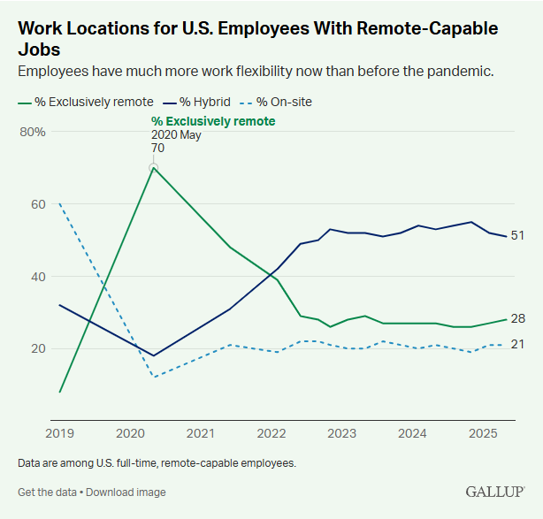
The Shift in Work Trends
Key Drivers:
COVID-19 pandemic accelerated remote work.
Advances in digital tools (Zoom, Slack, Teams).
Growing employee demand for flexibility.
Gallup, Inc. (2022, September 26). Indicator: Hybrid work. Gallup.com. https://www.gallup.com/401384/indicator-hybrid-work.aspx
Notes:
The pandemic accelerated a shift that was already starting. Technology and employee expectations for flexibility have made remote work a standard part of modern work environments.

Slide 3




Benefits of Remote Work
For Employees:
Flexibility and better work-life balance.
Reduced commute stress.
For Employers:
Larger talent pool.
Lower overhead costs.
Notes:
Remote work has strong advantages. Employees often enjoy more flexibility and less commuting stress, while employers can save money and access talent globally.

Slide 4

Benefits of In-Office Work
Collaboration & Culture: Easier brainstorming, stronger relationships.
Structure & Routine: Clear boundaries between work and home.
Resource Access: Immediate access to tools, technology, and support.
Note. Office Teamwork Stock Image
Notes:
On the other hand, being in the office offers stronger face-to-face collaboration, clearer routines, and quicker access to resources that support productivity.

Slide 5

Challenges of Each Model
Remote Work Challenges:
Isolation and communication gaps.
Harder to maintain company culture.
In-Office Challenges:
Commute time and costs.
Less flexibility for employees.
Notes:
Both models have drawbacks. Remote work can lead to isolation, while office work can feel rigid and increase commuting stress. The challenge is finding balance.

Slide 6

The Hybrid Future
Many Companies are adopting a hybrid model.
Combines Flexibility of remote ork ith collaboration of office ork.
Example: 3 Days in office, 2 days remote
Remote
Flexibility
Reduced Stress
In-Office
Structure and Routine
Collaboration
Notes:
The future is likely to be hybrid—a mix of both. This model allows companies to enjoy the best of both worlds: flexibility for employees and in-person collaboration when needed.

Slide 7

Conclusion / Key Takeaways
Remote work = flexibility, global talent, cost savings.
In-office work = culture, collaboration, structure.
Hybrid is emerging as the sustainable solution.
Note. Stock image search for success
Notes:
In conclusion, remote and in-office work both have unique strengths and challenges. The hybrid model is becoming the most sustainable option, blending flexibility with collaboration. Organizations that adapt will be best positioned for the future.

